Slide 1
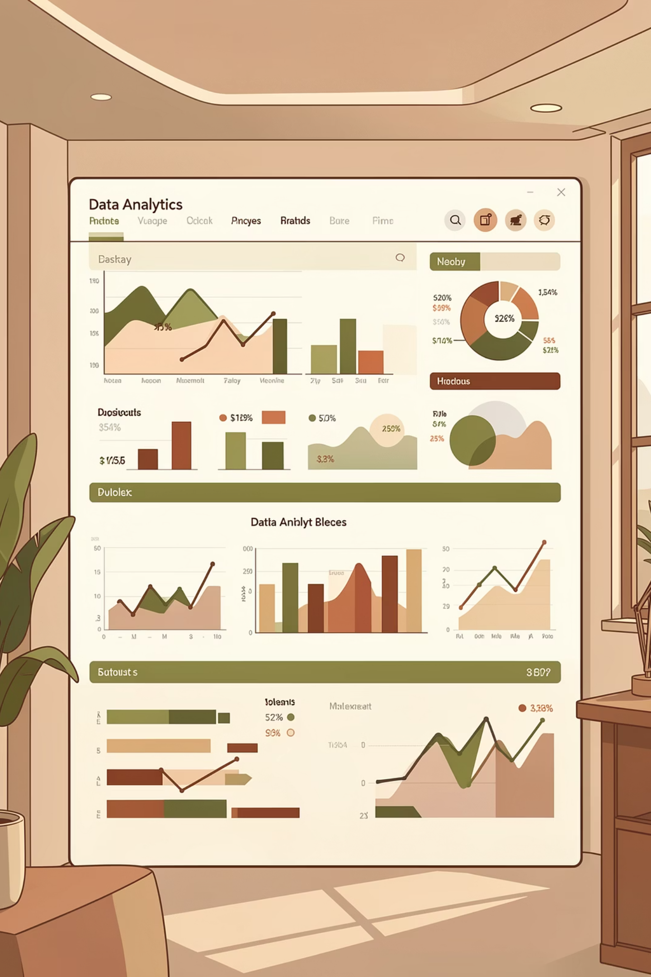
Customer Shopping Behavior Analysis
Uncovering insights from 3,900 purchases to drive strategic decisions

Slide 2
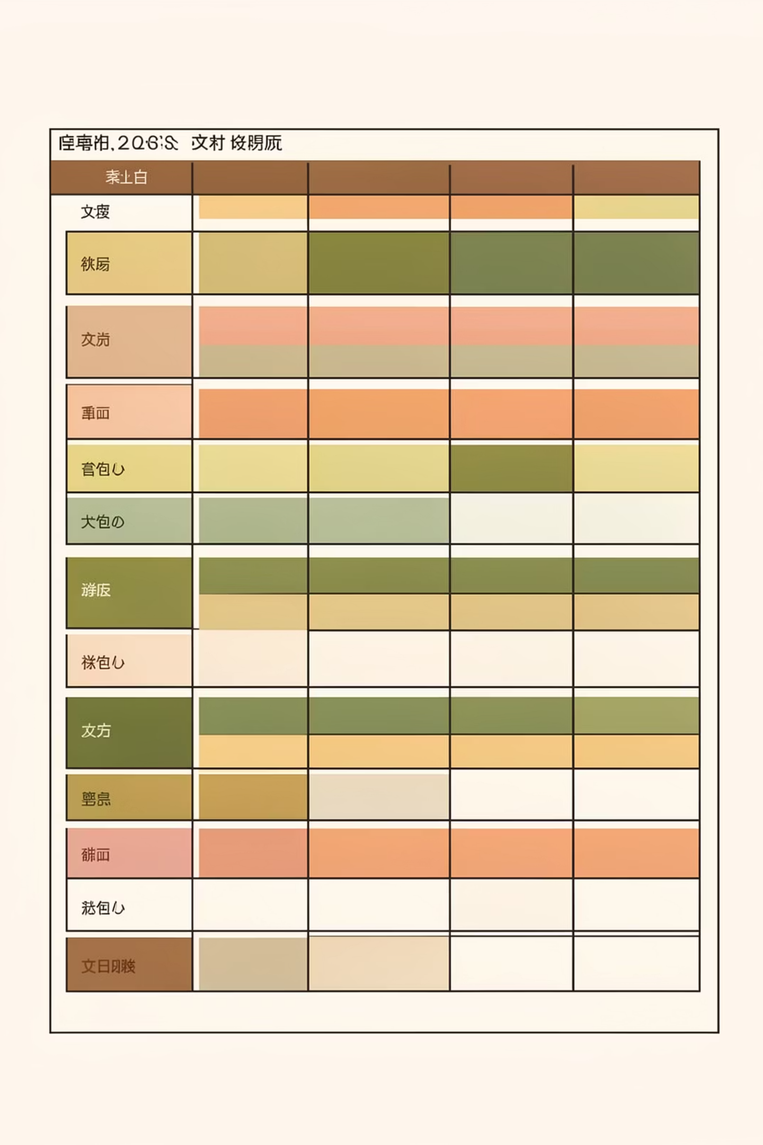
DATASET OVERVIEW
The Foundation
3,900
18
37
Total Purchases
Data Points
Missing Values
Transactions analyzed
Features per transaction
In review ratings only

Slide 3
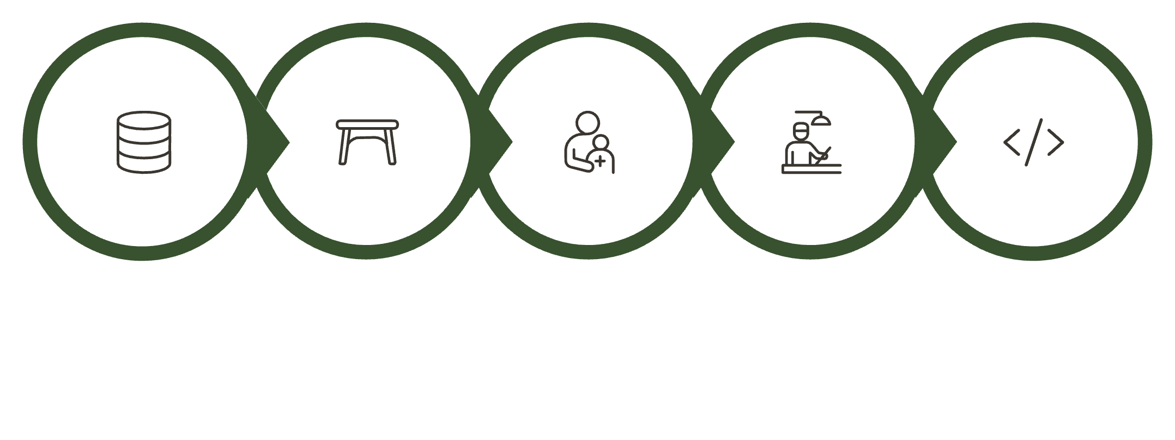

Data Preparation Journey
Key Transformations
Imputed missing ratings using category medians
Created age groups for segmentation
Standardized column naming conventions
Removed redundant promo code field
Load Data
Explore Structure
Handle Missing
Engineer Features
Connect to MySQL
Systematic approach to ensure data quality and consistency

Slide 4

Revenue Insights by Gender
Male Customers
Female Customers
Higher total revenue contribution
Strong purchasing power

Slide 5
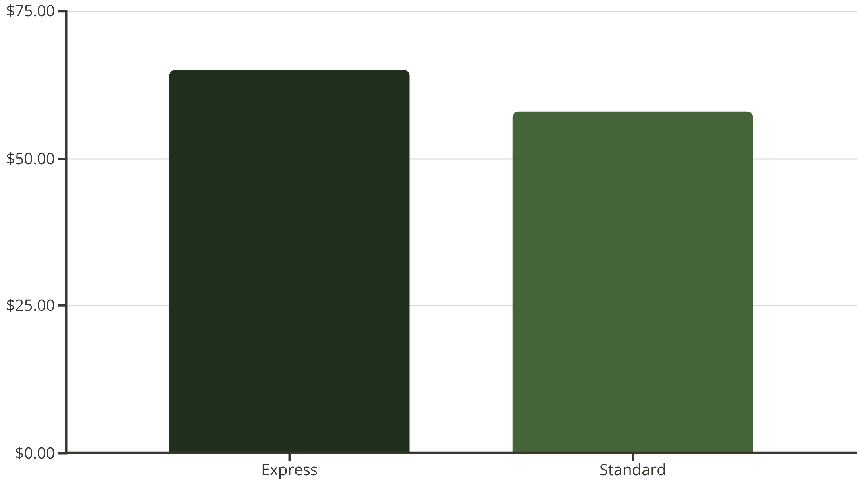
Shipping & Subscription Analysis
Key Findings
Express shipping users spend more per transaction
Subscribers generate higher average spend and total revenue
Opportunity: Promote express shipping and subscription benefits

Slide 6



Top-Rated Products
Blouse
Jewelry
Dress
Highest customer ratings
Premium satisfaction scores
Consistent positive reviews

Slide 7

CUSTOMER SEGMENTATION
Understanding Customer Loyalty
New Customers
First-time buyers
Returning
2-5 purchases
Loyal
6+ purchases
Repeat buyers with 5+ purchases show higher subscription rates

Slide 8
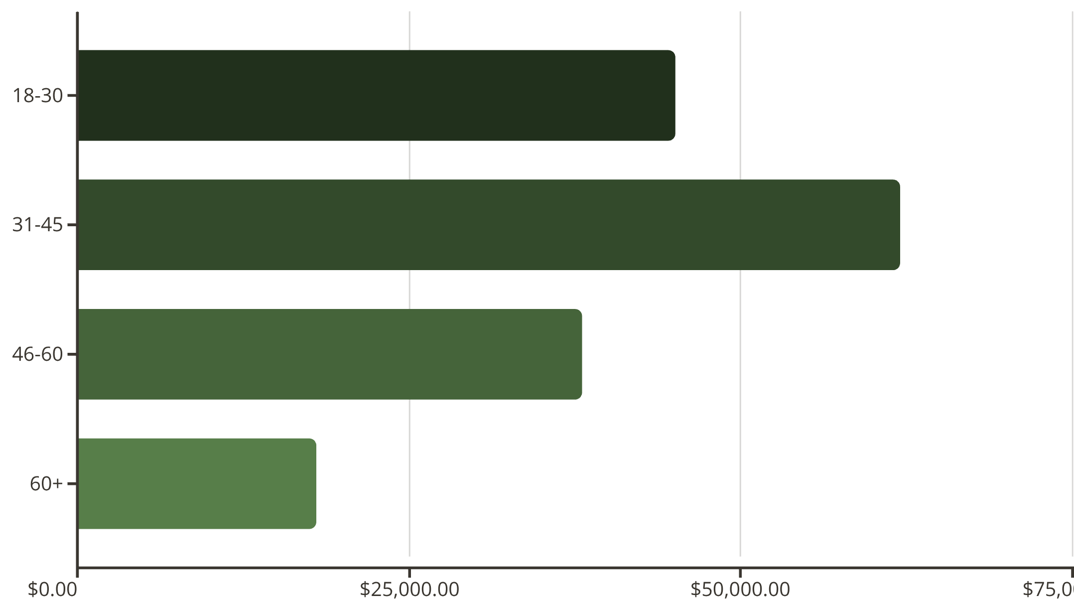
Revenue by Age Group
Age Group Insights
31-45 age group drives highest revenue
Young adults (18-30) show strong purchasing activity
Target marketing efforts toward high-value segments

Slide 9
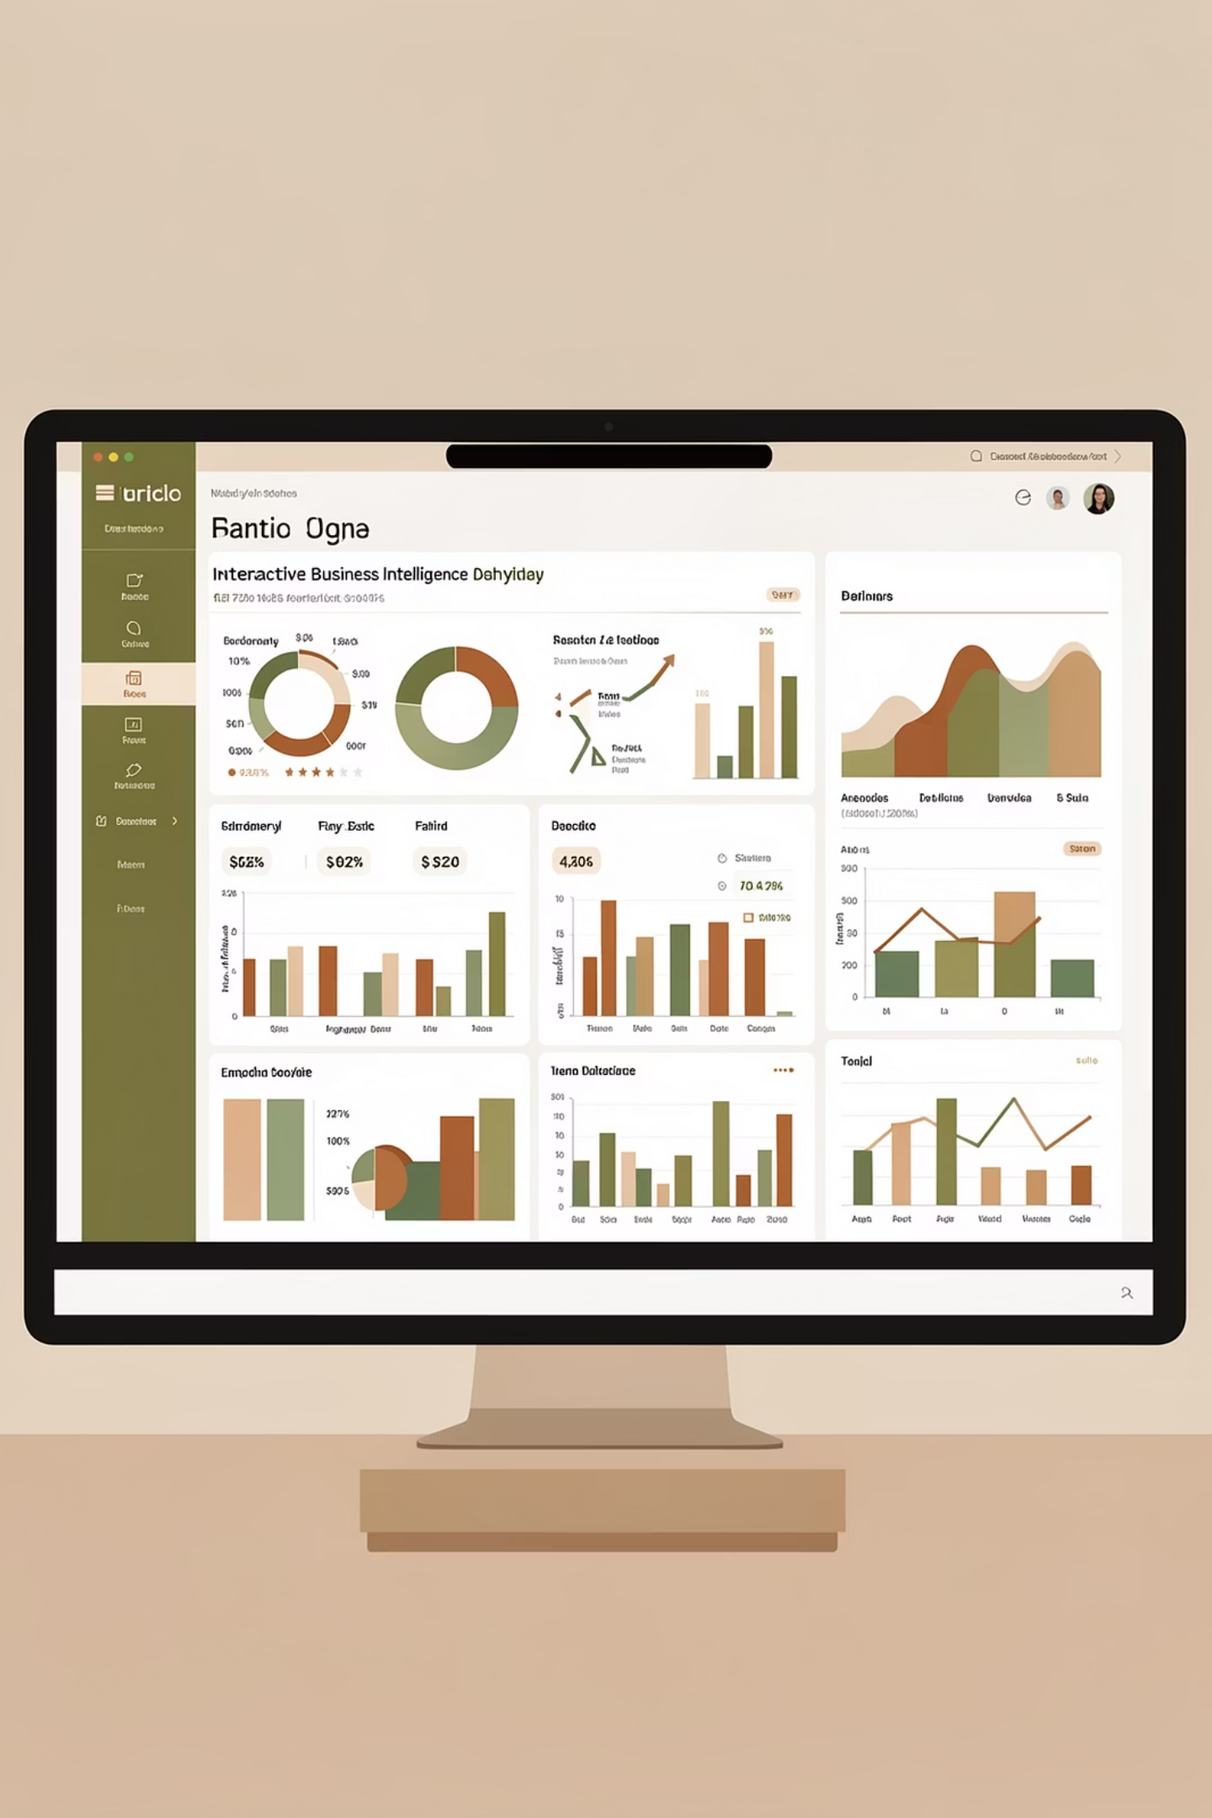
Power BI Dashboard
Interactive visualization bringing all insights together
Real-Time Insights
Visual Storytelling
Dynamic filtering and exploration
Clear, actionable metrics

Slide 10




RECOMMENDATIONS
Strategic Next Steps
Boost Subscriptions
Loyalty Programs
Promote exclusive benefits
Reward repeat buyers
Targeted Marketing
Product Positioning
Focus on high-revenue segments
Highlight top-rated items

